Slide 1

Engineering Future!

Slide 2
Agenda
Introduction
Future of Industries
Future of Machines
First Principles Thinking!
Questions

Slide 3
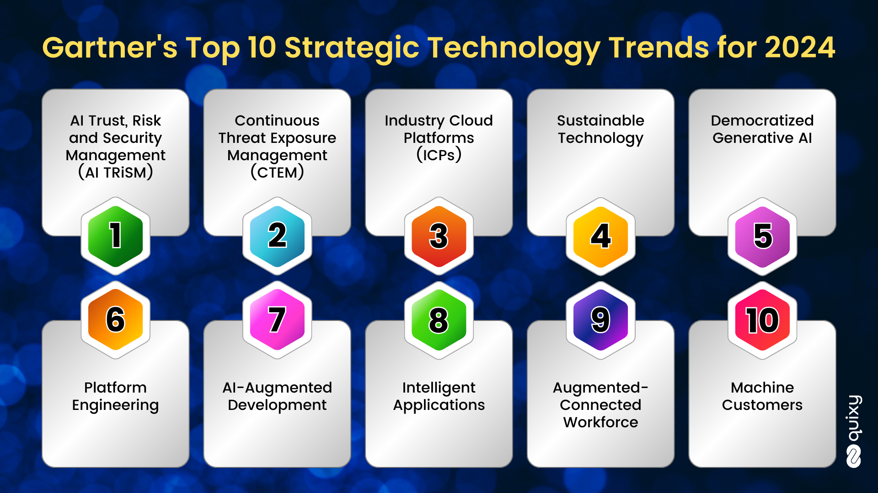

Slide 4
Future of Industries
Progression from Industry 4.0 to Industry 5.0

Slide 5
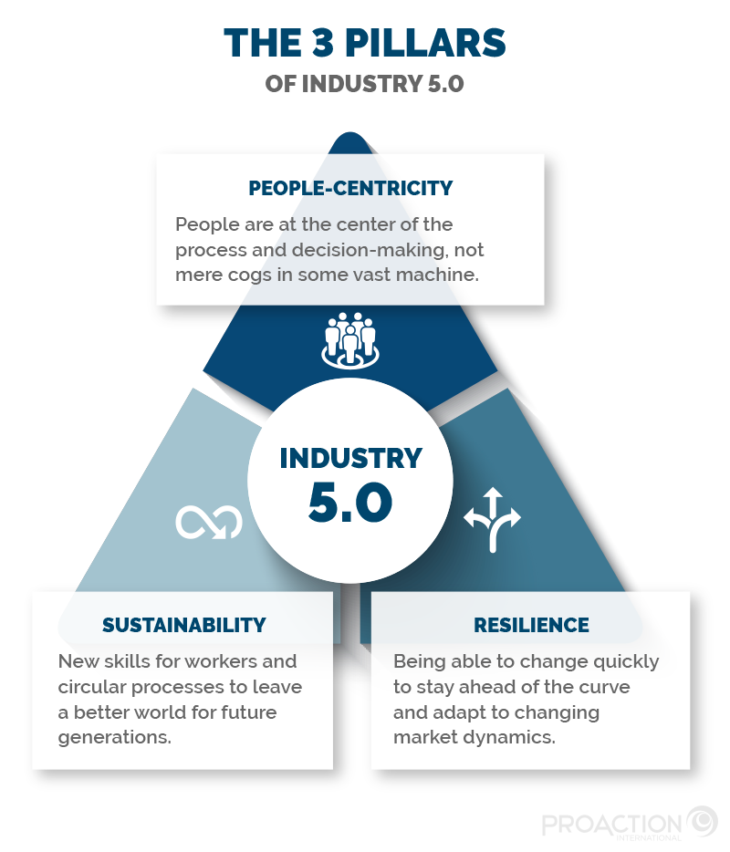

Slide 6
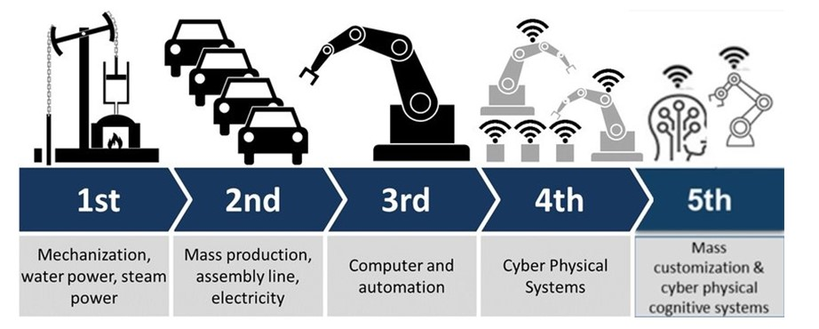

Slide 7
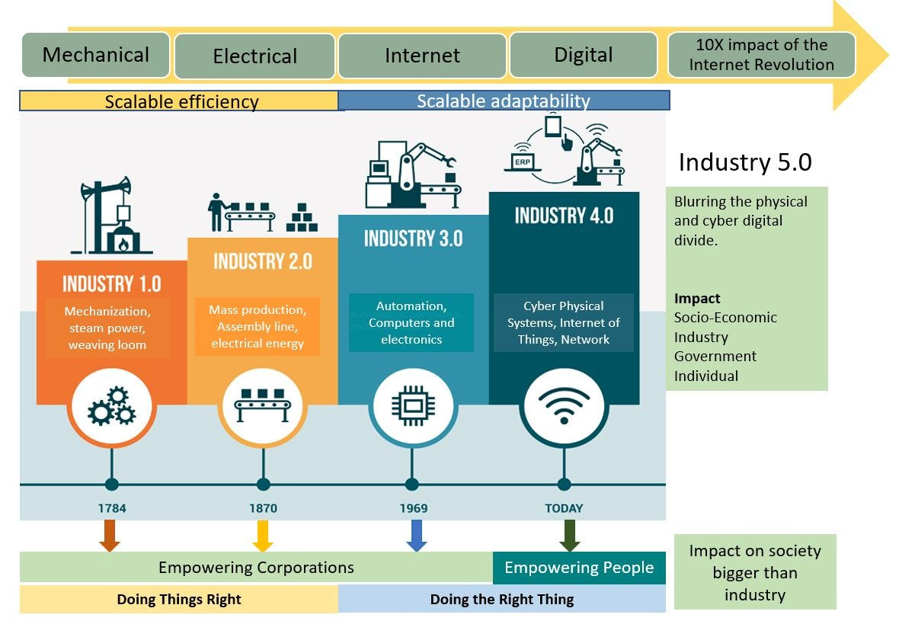

Slide 8
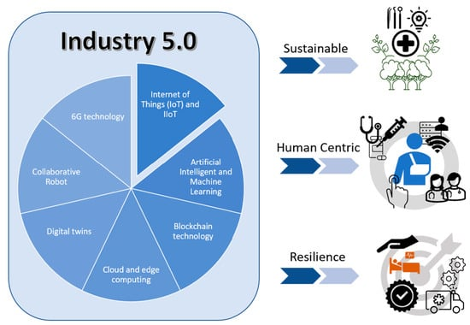

Slide 9
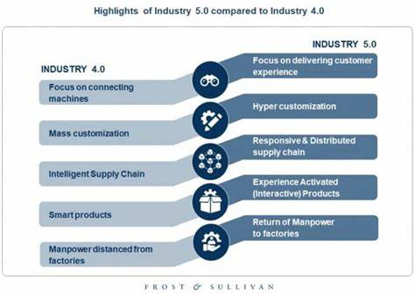

Slide 10

Navigating The Currents of Chaos

Slide 11
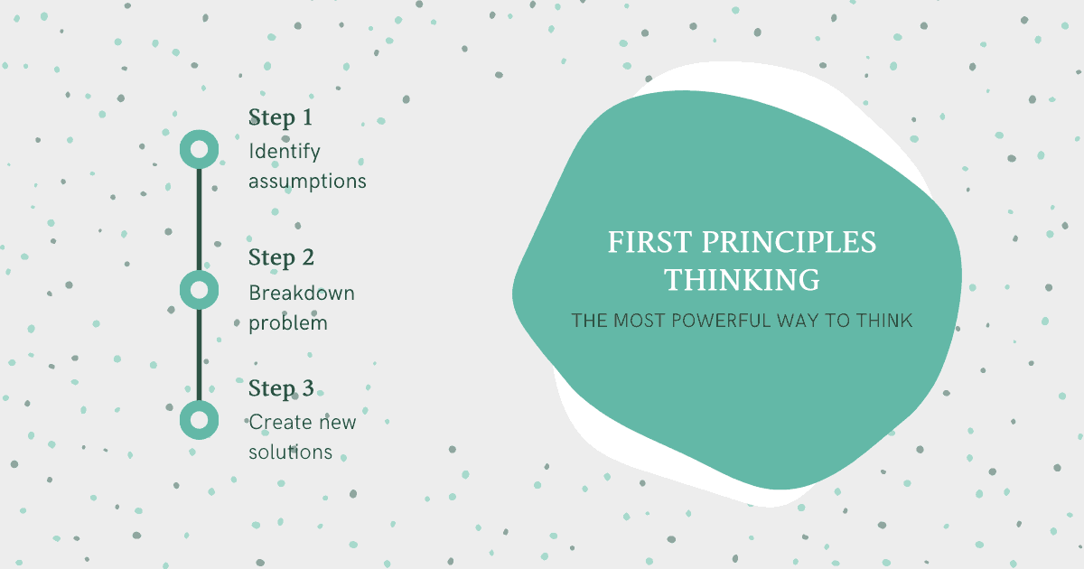

Slide 12
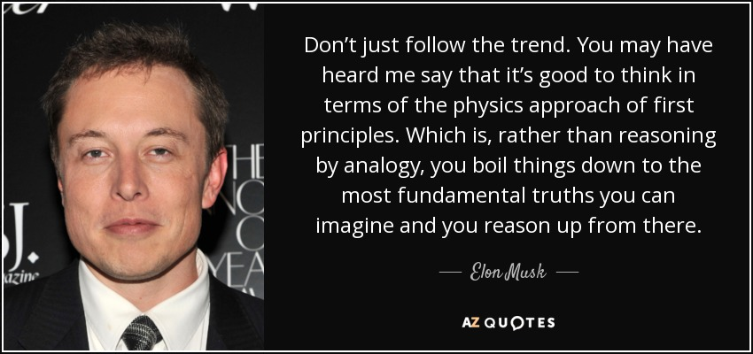

Slide 13

Understanding First Principles
Blending Creativity and Deep Knowledge

Slide 14
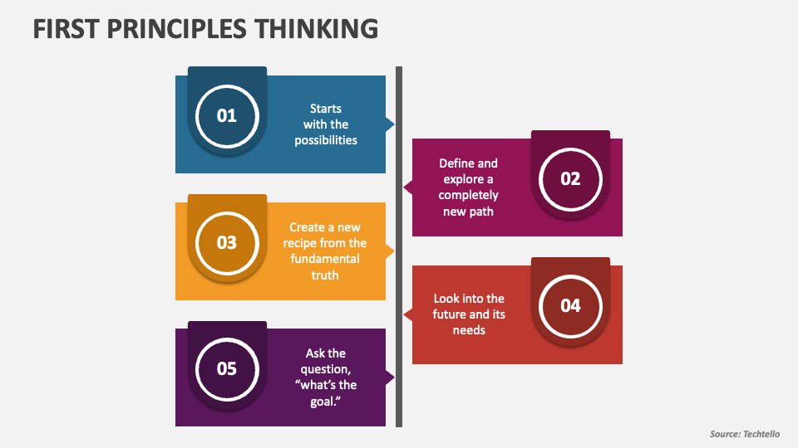

Slide 15
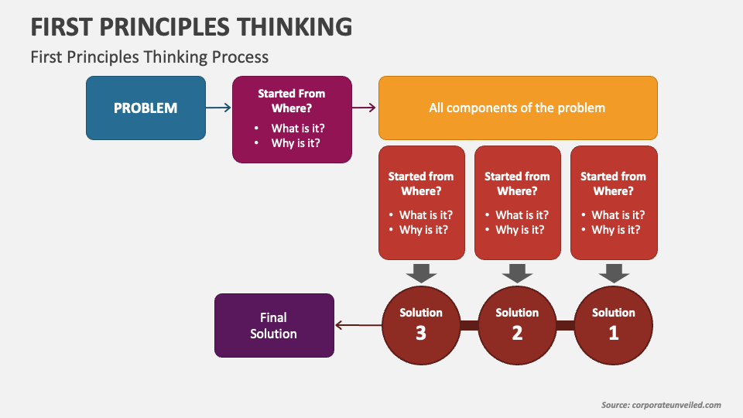

Slide 16
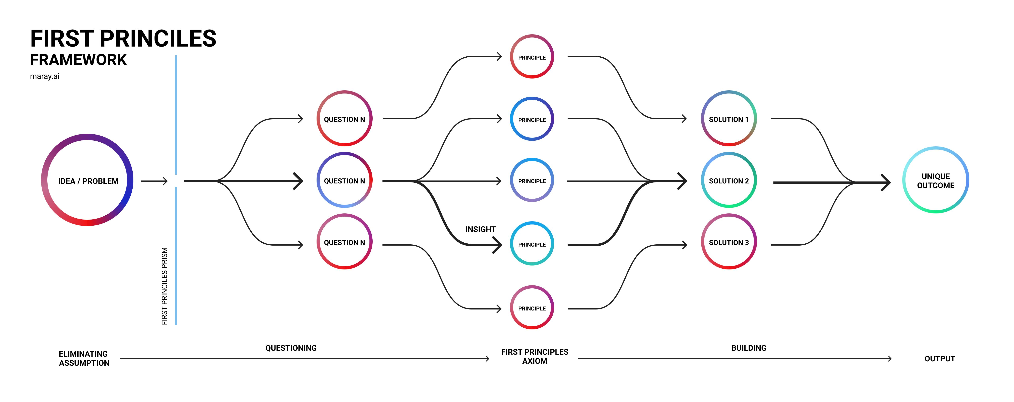

Slide 17

Future Machines Framework
Convergence of Fairness, Focus, and Facts

Slide 18
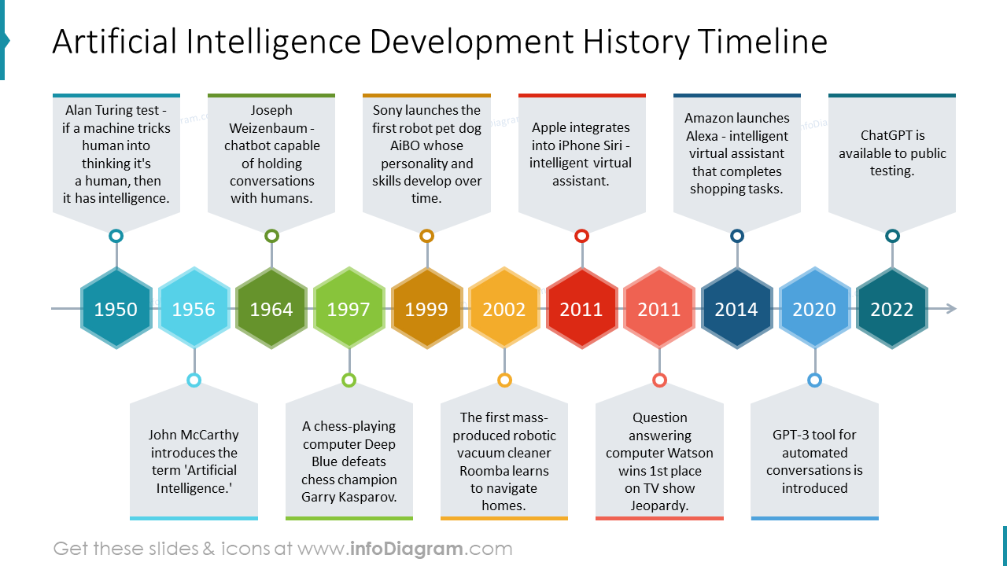

Slide 19
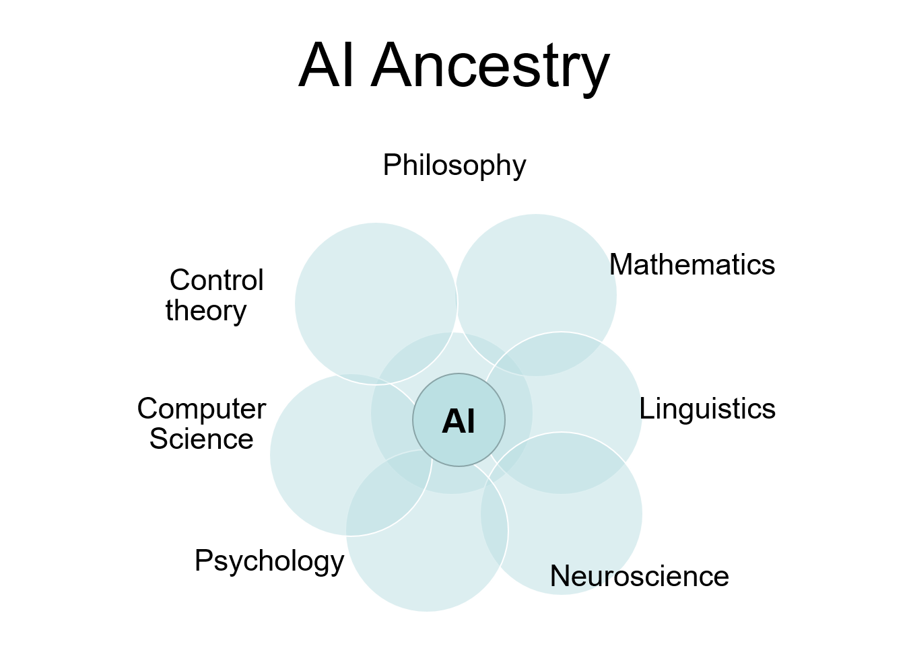

Slide 20
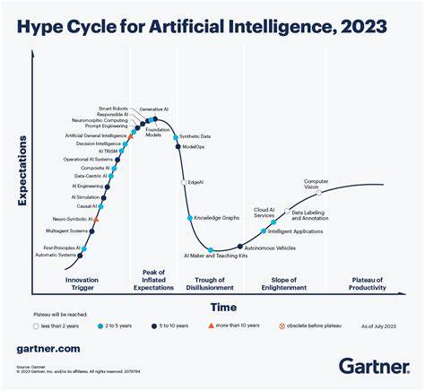

Slide 21
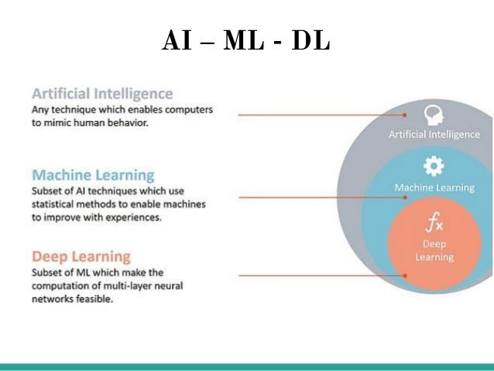

Slide 22
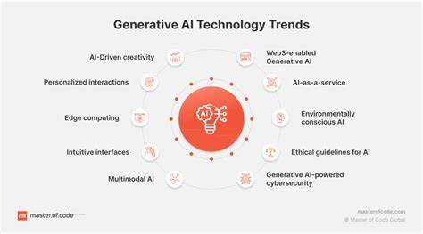

Slide 23
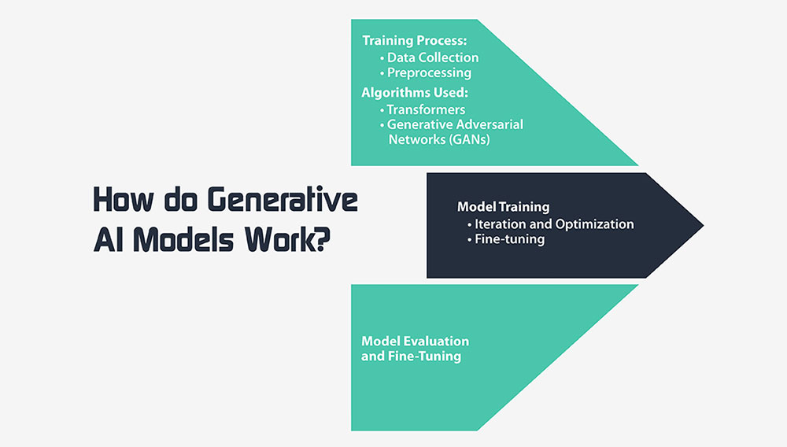

Slide 24
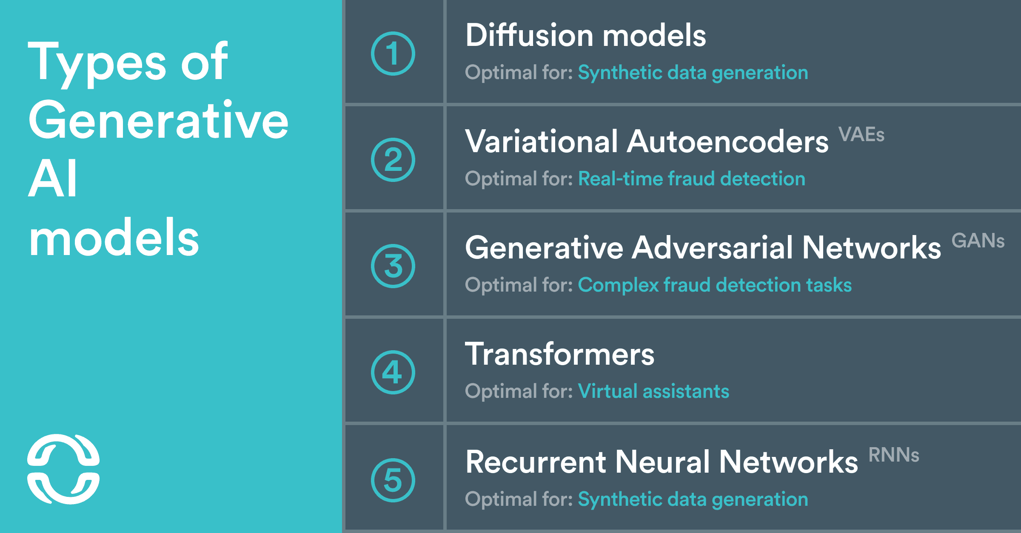

Slide 25

Thank you
Gokul Alex
www.twitter.com/@gokulgaze
www.linkedin.com/in/gokulgaze
gokulalex@gmail.com
www.gokulbalex.wordpress.com

